Slide 1
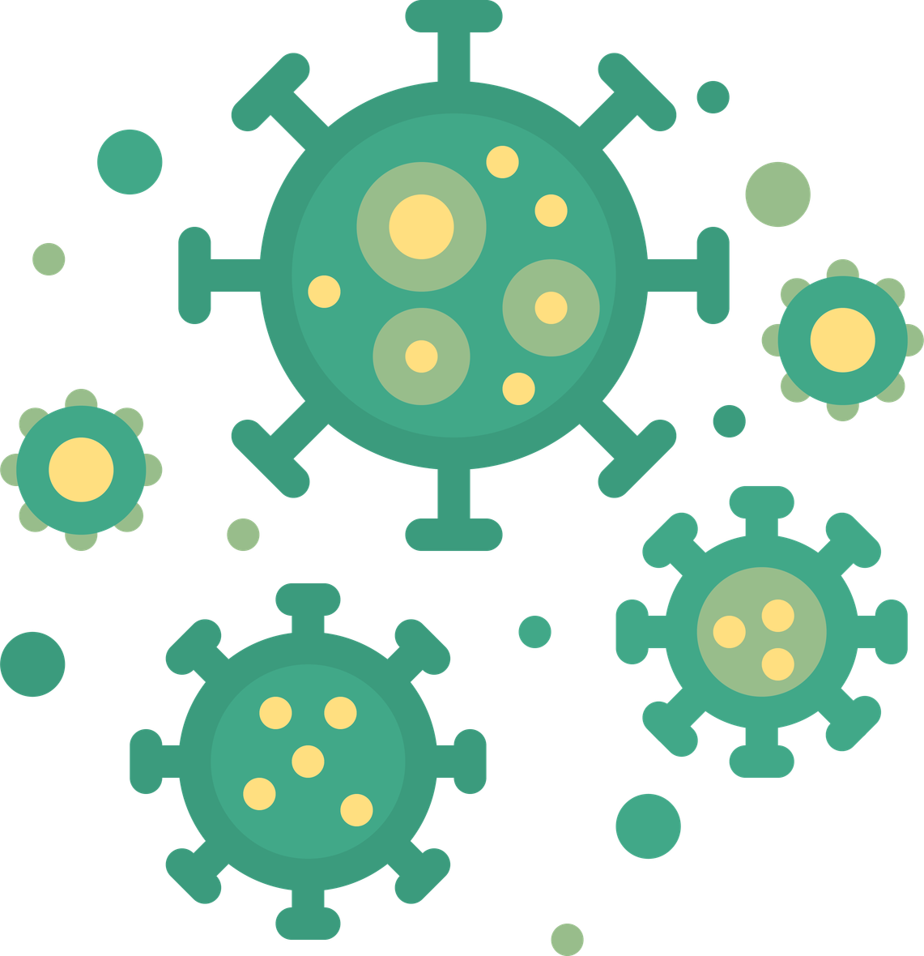
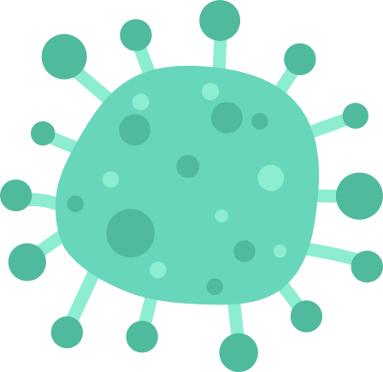


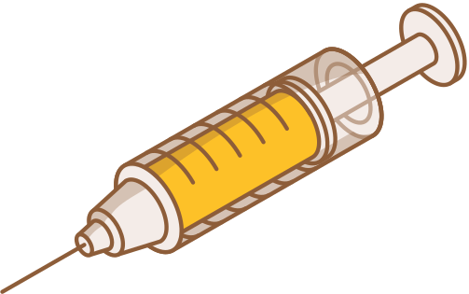
VAC
Presentation

Slide 2
Value addion course
(Science & Society)
Yash Chaurasiya (Bsc.(hons)C.S.)
University roll no. = 24035570081
College roll no. = 24/BS(H)CS/25830
Satyam Singh(Bsc.(hons)Maths.)
University roll no. = 24035563045
College roll no. = 24/BS(H)MT/26144

Slide 3
The Invisible Battleground
The Hook: We live in a world teeming with trillions of microbes. Most are friends; some are foes.
The Three Pillars: *
Vaccines: Our training ground.
Antibiotics: Our emergency response.
AMR: The ultimate evolutionary challenge.
The Human Connection: Every major medical advancement—from basic surgery to cancer treatment—relies on these three pillars staying strong.

Slide 4
Teaching the Body to Fight
The Concept: Think of a vaccine as a "Most Wanted" poster for your immune system.
Detailed Content:
Immune Memory: Vaccines introduce a harmless "ghost" or fragment of a germ. Your body builds a specialized army (antibodies) without you ever getting sick.
The "Training" Phase: When the real virus attacks months later, your body recognizes it instantly and neutralizes it before it can take hold.
The Human Element: It’s not just about "you." It’s about Herd Immunity—protecting the baby who is too young for a shot or the grandmother whose immune system is tired.

Slide 5
Antibiotics – The 20th Century Miracle
The History: Before 1928, a simple scratch from a rose thorn or a sore throat could be a death sentence.
How They Work (Humanized):
The Sniper Approach: Antibiotics are designed to attack parts of a bacterial cell that human cells don't have (like cell walls).
The Success Story: They turned lethal diseases like pneumonia, syphilis, and tuberculosis into manageable conditions.
The Misconception: Antibiotics are "bacteria-only." Using them for a viral cold is like bringing a sword to a ghost fight—it doesn't hit the target and only causes collateral damage.

Slide 6
The Rise of the Superbug (AMR)
The Crisis: Antimicrobial Resistance (AMR) is what happens when germs develop "superpowers" to survive the drugs designed to kill them.
The Mechanism of Survival:
Mutation: Bacteria reproduce every 20 minutes. If one survives a weak dose of antibiotics, it learns, adapts, and passes that "resistance gene" to its offspring.
The Result: We are running out of working medicine. Routine surgeries like C-sections or hip replacements could soon become life-threatening due to untreatable infections.

Slide 7
Why is AMR Getting Worse? (Our Role)
Human Behavior: * Stopping Early: When you feel better and stop your meds, the weakest bacteria are dead, but the strongest are still alive. You've essentially "trained" the survivors.
The "Just in Case" Culture: Demanding antibiotics for a cough or flu "just to be safe" accelerates resistance.
The Global Kitchen: 70% of medically important antibiotics are used in animal agriculture not to treat sick animals, but to make them grow faster. We are eating the consequences.

Slide 8
The "Post-Antibiotic" Era – A Warning
The Scenario: Imagine a world where a common UTI (Urinary Tract Infection) cannot be cured, leading to kidney failure.
The Stats: AMR is already linked to nearly 5 million deaths globally per year. By 2050, it could kill more people than cancer.
The Human Impact: Modern medicine is a "house of cards." If the bottom layer (antibiotics) collapses, everything else—chemotherapy, organ transplants, and intensive care—falls with it.

Slide 9
Vaccines as the Secret Weapon against AMR
The Logic: You don't need antibiotics for an infection you never catch.
How Vaccines Help:
Reduced Usage: Fewer infections mean fewer prescriptions.
Targeting the Source: Vaccines like the PCV (Pneumococcal) have drastically reduced the spread of drug-resistant pneumonia strains.
The Takeaway: Vaccination isn't just about preventing a virus; it’s a strategic move to preserve our existing antibiotic supply.

Slide 10
The Path Forward – What Can We Do?
Scientific Innovation: We need "Phage Therapy" (using viruses to kill bacteria) and new classes of drugs.
Policy Changes: Restricting antibiotic use in farming and improving hospital sanitation.
Your Personal Responsibility:
Hygiene: Simple handwashing is the first line of defense.
Patience: Trusting doctors when they say "it's a virus, you don't need a pill."
Advocacy: Supporting global health initiatives to ensure everyone has access to clean water.

Slide 11
Summary – The Balance of Power
The Partnership: We are in a constant race with nature.
Prevention (Vaccines) > Treatment (Antibiotics).
Respect the Meds: We must treat our remaining antibiotics as a precious, non-renewable resource.
Final Quote: "The bacteria are smart, but humans are supposed to be smarter. Let's act like it."

Slide 12
THANK YOU!

